Slide 1
Lock-in Amplifiers
Kelvin Paa Kwesi Adjei and Michelle Kim
E72 Final Project

Slide 2
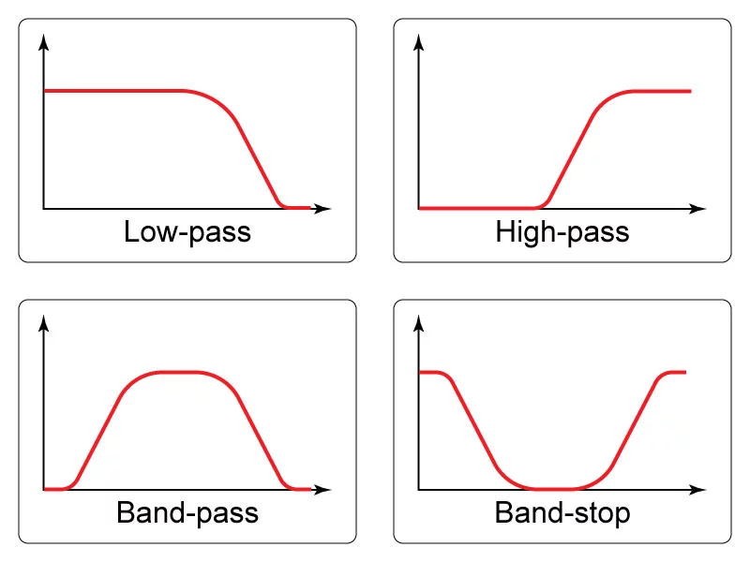
Filters
Easy to implement
Do not perfectly filter out specific frequencies
Cause time delays
Notes:
Before we talk about Lock in amplifiers, we wanted to talk about other methods for honing in on a frequency.
The first method is to use filters, which we’ve all had experience with. Filters are useful for rejecting noise that is far away in frequency from the signal of interest. (even for the band pass, there is a band width that weakens precision) Filters are easy to construct and they work in real time, giving a filtered signal without the need for numerical analysis.
michelle

Slide 3
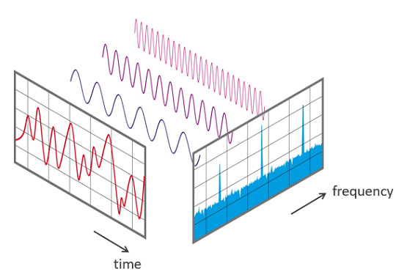
Fourier Transform
Better properties than real-time filters
Require numerical analysis
Notes:
We have also used fourier transforms in e12 to hone in on a specific frequency of a signal. These have better properties than real-time filters, but they require numerical analysis. However, in order to detect a very weak signal, we must use a lock in amplifier.
michelle

Slide 4
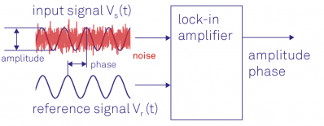
Why use a Lock-in Amplifier?
Able to “lock in” on a signal
Need to know the frequency of the signal you are looking for
Useful to find weak signals within large amounts of noise
Notes:
Lock in amplifiers take in a noisy input signal and a reference signal, which is the same frequency of the signal that we are looking for. It will “lock -in” on the signal of that frequency and amplify it, while rejecting all other frequencies. This is very useful if you know the frequency of the signal that you are looking and if the signal is a weak signal.
michelle

Slide 5
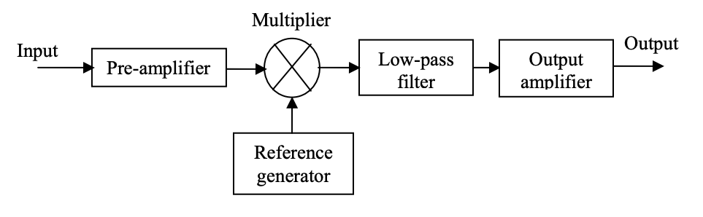
Configuration
Notes:
Input is fed to multiplier with reference signal, multiplier multiplies input with reference signal and output is passed through a LPF which outputs A DC signal which is amplified by the output amplifier

Slide 6
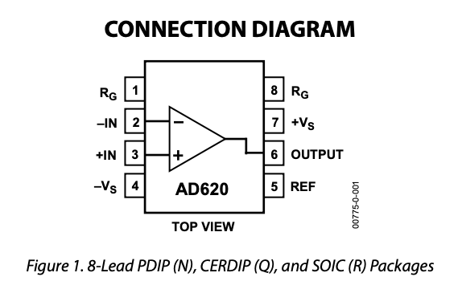
Configuration
Instrumentation Amplifier (Not Op- Amp)
Notes:
Instrumentation amplifier not op-amp.
Outputs an amplified signal with finite gain
Gain controlled by connecting resistor across pins 1 and 8

Slide 7
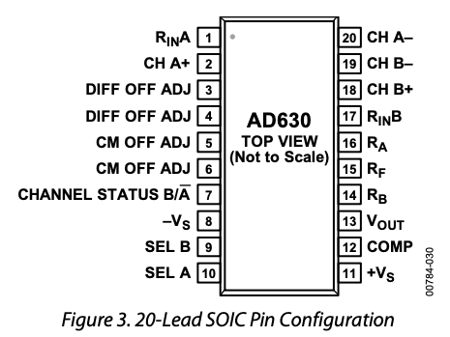
Configuration
Synchronous Demodulator
Notes:
Synchronous demodulator compares the amplified input with reference signal and multiplies it by +/-2 depending on whether input is +ve or -ve

Slide 8
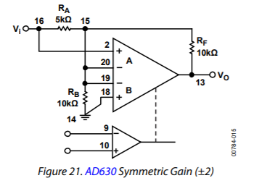
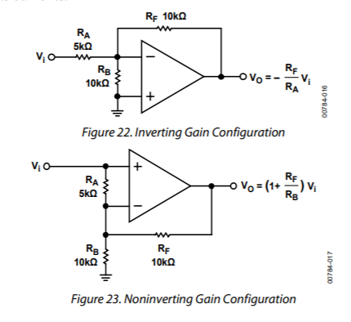
How the AD630 Works
Notes:
When +>-, comparator is high
We grounded the + and made the reference wave the - terminal. This means when reference wave is +, gain is -2 and when reference wave is negative, gain is +2

Slide 9
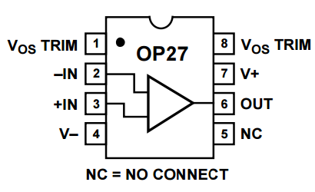
Configuration
Precision Amplifier (Not Op- Amp)

Slide 10
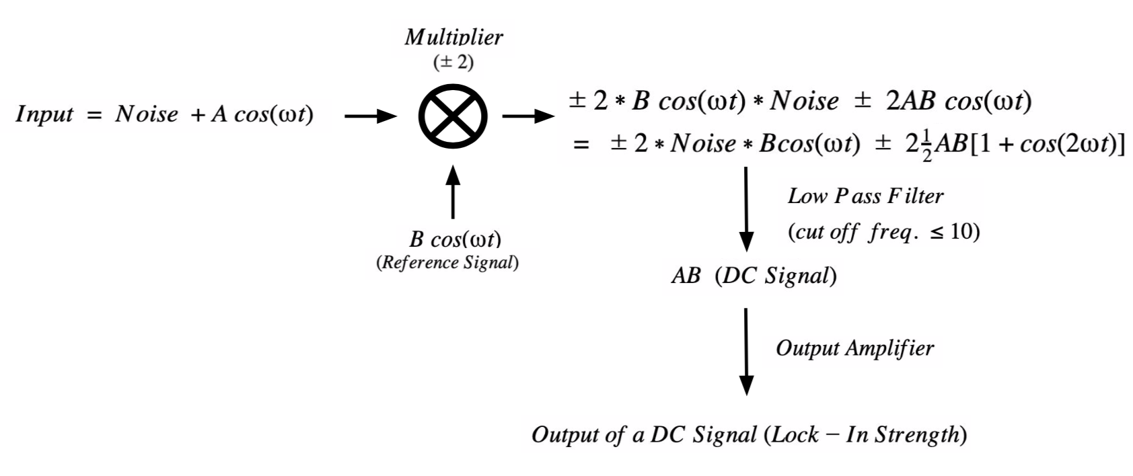
Math Behind How Lock In Amplifier Works

Slide 11
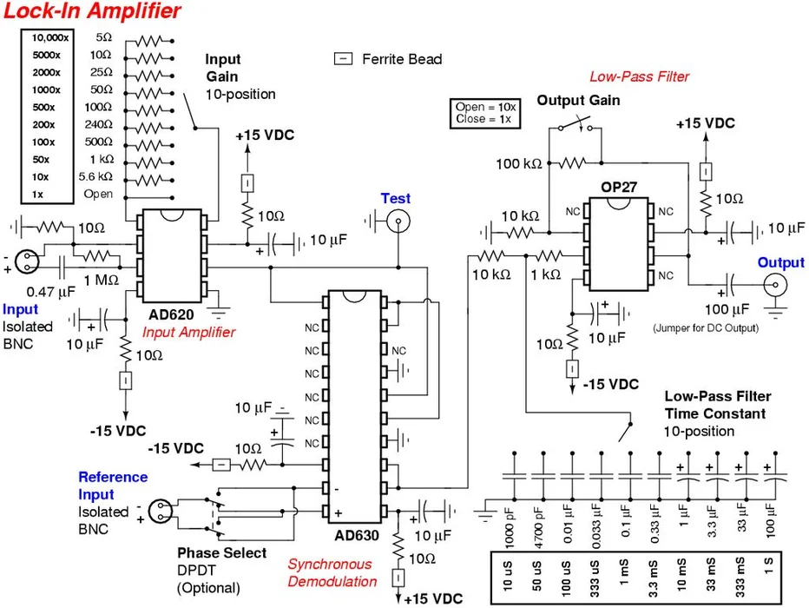
Circuitry

Slide 12
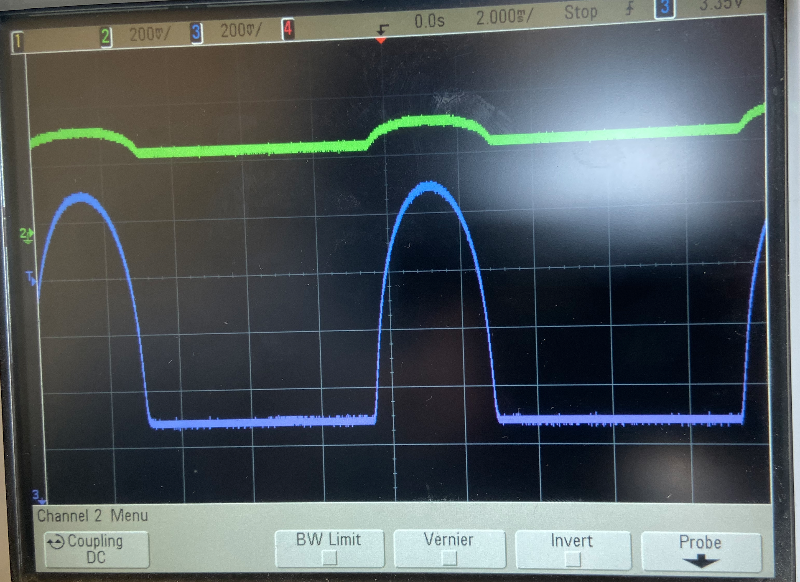
Results: Input Amplifier
Green: Input
Blue: Amplified Output
Notes:
As you can see, our input amplifier works as expected. The green signal is the input and the yellow signal is hte output. Also, the yellow is at 200mv per division and the green is at 100mv per division, so the amplification is a bit more drastic than demonstrated, with a gain of about 100x.

Slide 13
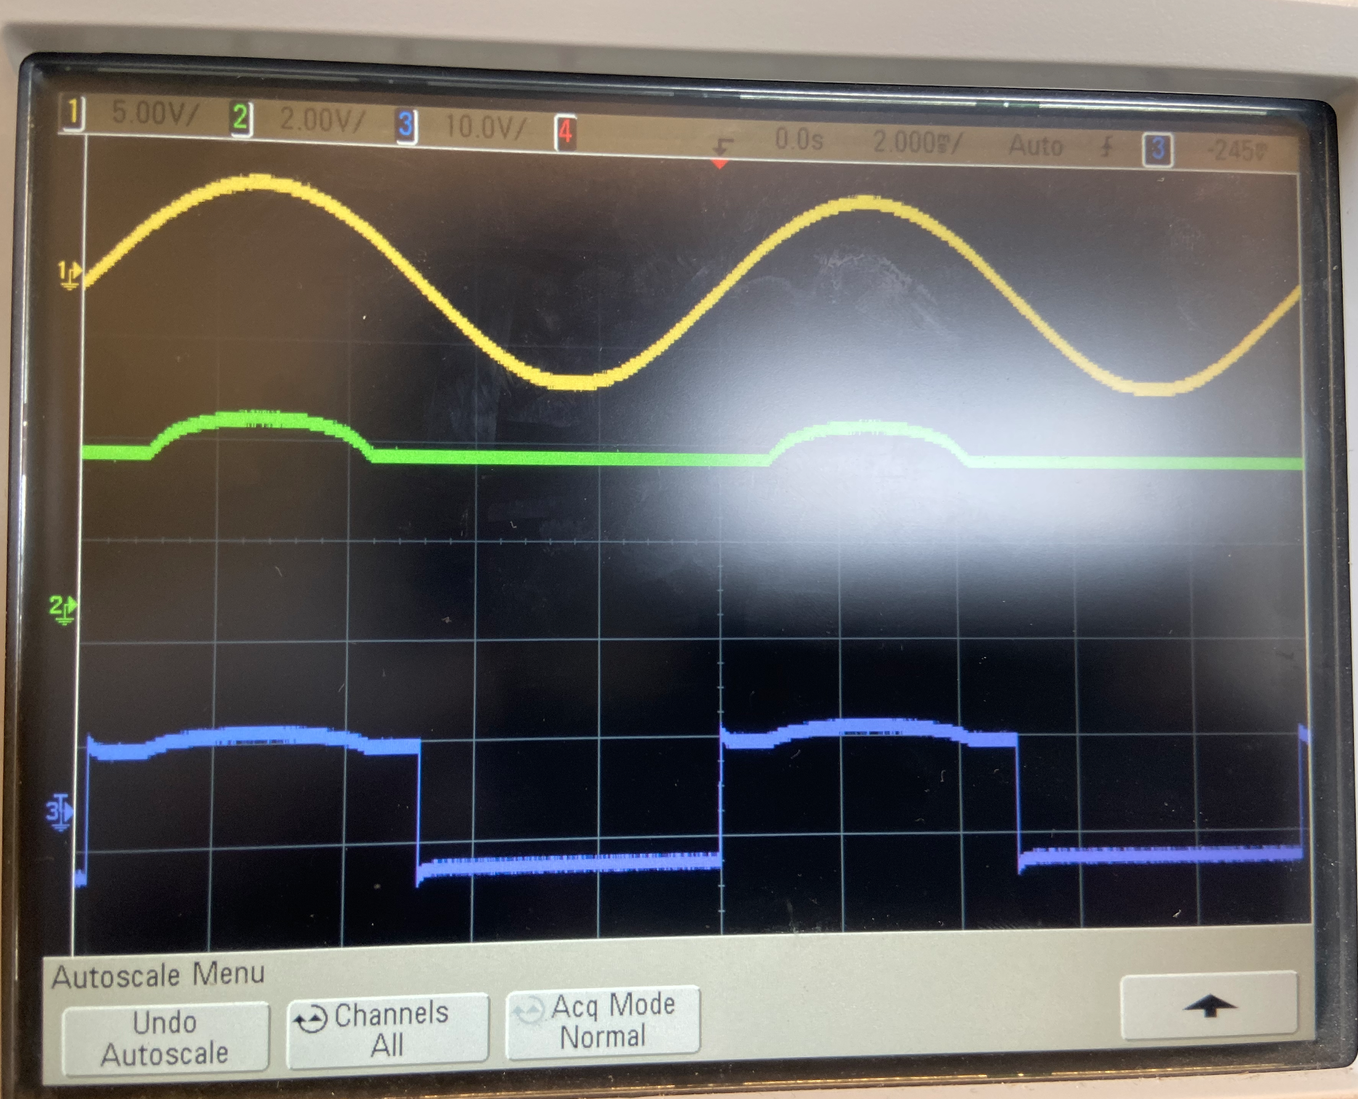
Results: Synchronous Demodulation
Yellow: Reference wave
Green: Input
From Input Amplifier
Blue: Output
Notes:
Here we can see the result of the syncrhonous demodulation, which is the multiplier. The yellow line is the output, the green line is the reference wave, and the blue line is the input. In this graph, when the reference wave (the negative terminal) is positive, it is greater than the + terminal
When reference signal s positive,

Slide 14
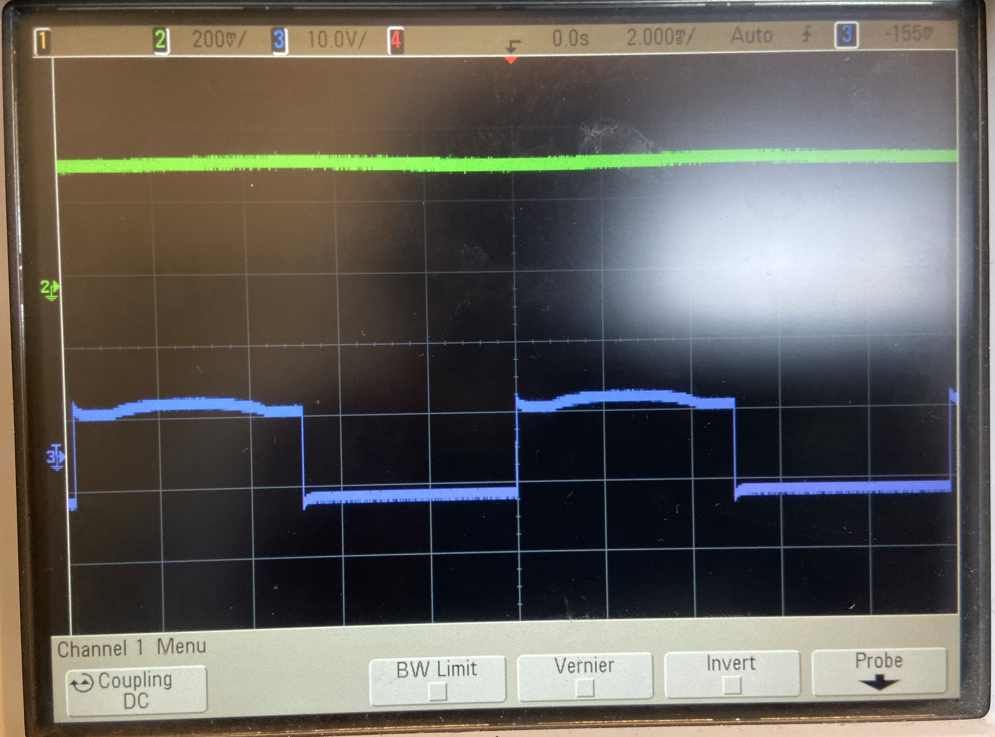
Results: Low-Pass Filter
Blue: Input from AD630
Green: Filtered Output

Slide 15
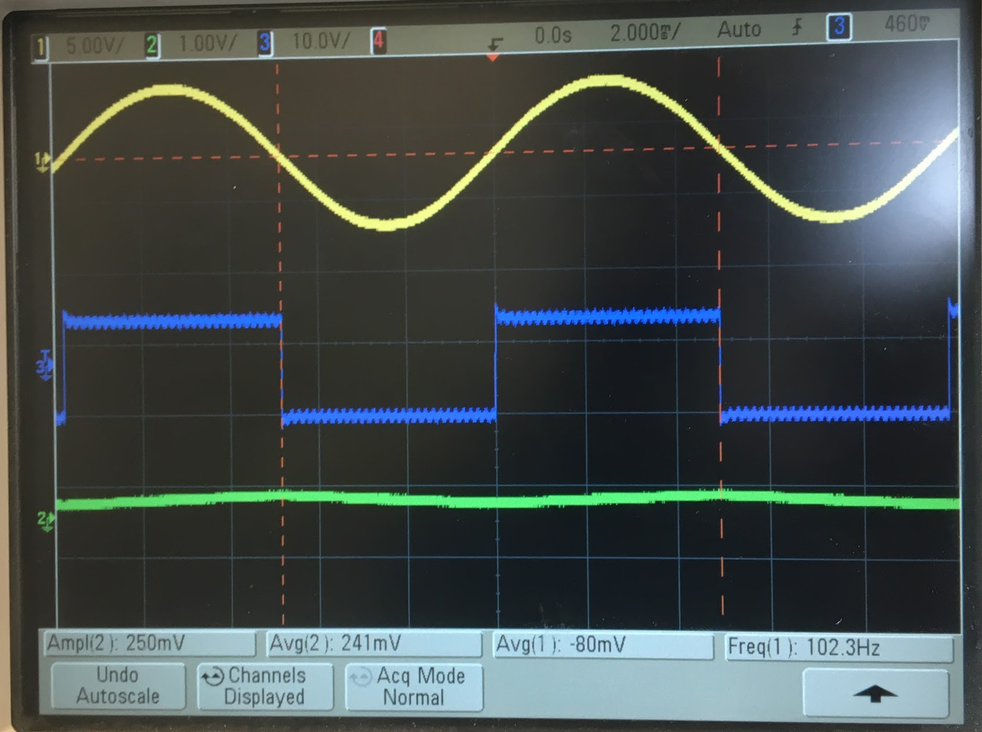
Results: Output of Lock In Amplifier (Noise Input Only)
Output from AD630 (Blue)
Output from output amplifier (Green)
Reference Signal (Yellow)

Slide 16
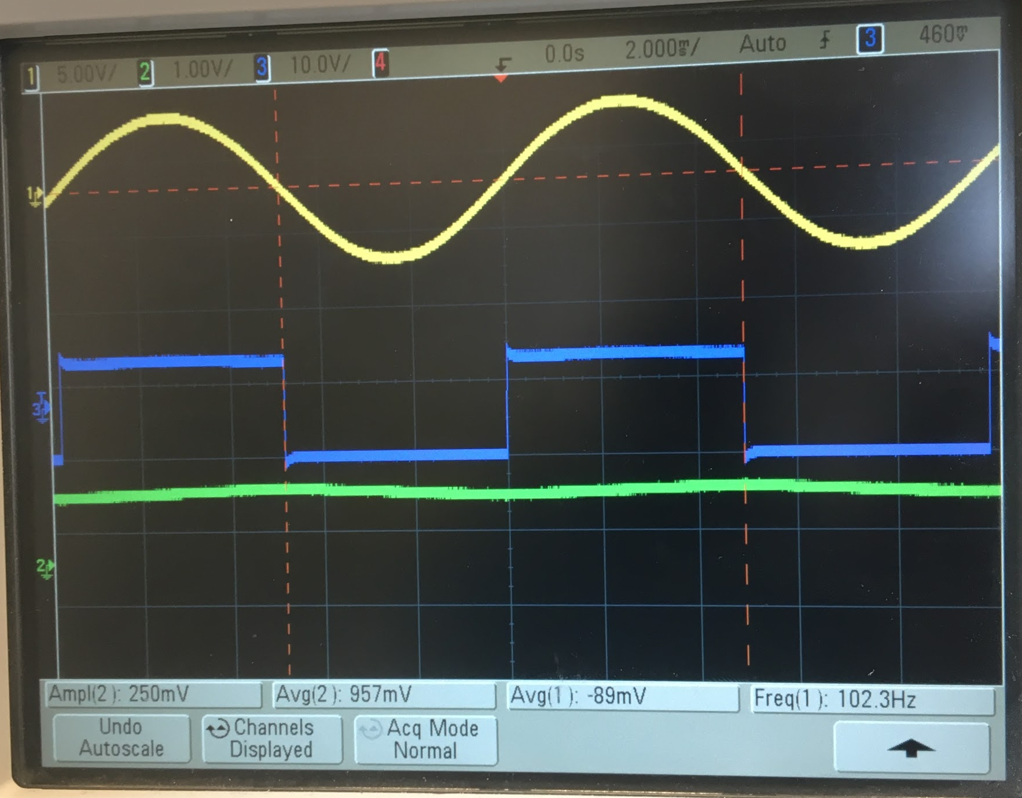
Results: Complete Lock-In Amplifier
Output from AD630 (Blue)
Output from low pass filter (Green)
Reference Signal (Yellow)

Slide 17

Demo

Slide 18
Significance/ Future Work
Detection of really small signals in noisy environments.
Used in precision AC and DC phase meters, noise measurement units, impedance spectroscopes, network analyzers, spectrum analyzers and phase detectors in phase-locked loops.
Future work can be done on improving the lock-in strength of our Lock-In amplifier and phase shift control could be added to reference signal.
Design of a Digital Lock-In amplifier on an FPGA (Implements signal mixing and LPF on a fast digital signal processor)

Slide 19
Links
https://www.princeton.edu/~romalis/PHYS312/Lock-in%20amplifier.pdf
https://www.instructables.com/id/Lock-in-Amplifier/
https://nationalmaglab.org/images/news_events/searchable_docs/summerschool/2016/lockin_amplifier_kowitt.pdf
https://www.edn.com/design/test-and-measurement/4459202/Design-a-DSP-lock-in-amplifier--Part-1--Background
https://www.edn.com/design/test-and-measurement/4459206/Design-a-DSP-lock-in-amplifier--Part-2--Design-methodology
AD630 Data Sheet

